Slide 1
Specifiche Home Page ICS – Paolo Vasta Damiano Gammino (O46002074) A.A. 2020/2021

Slide 2

Header
100% dello schermo
600px

Slide 3

Nav
100% dello schermo
80px
div #logo
div #links
712 px
375 px
40px
16px

Slide 4


h1
1063px
90px
a.button
274px
43px

Slide 5
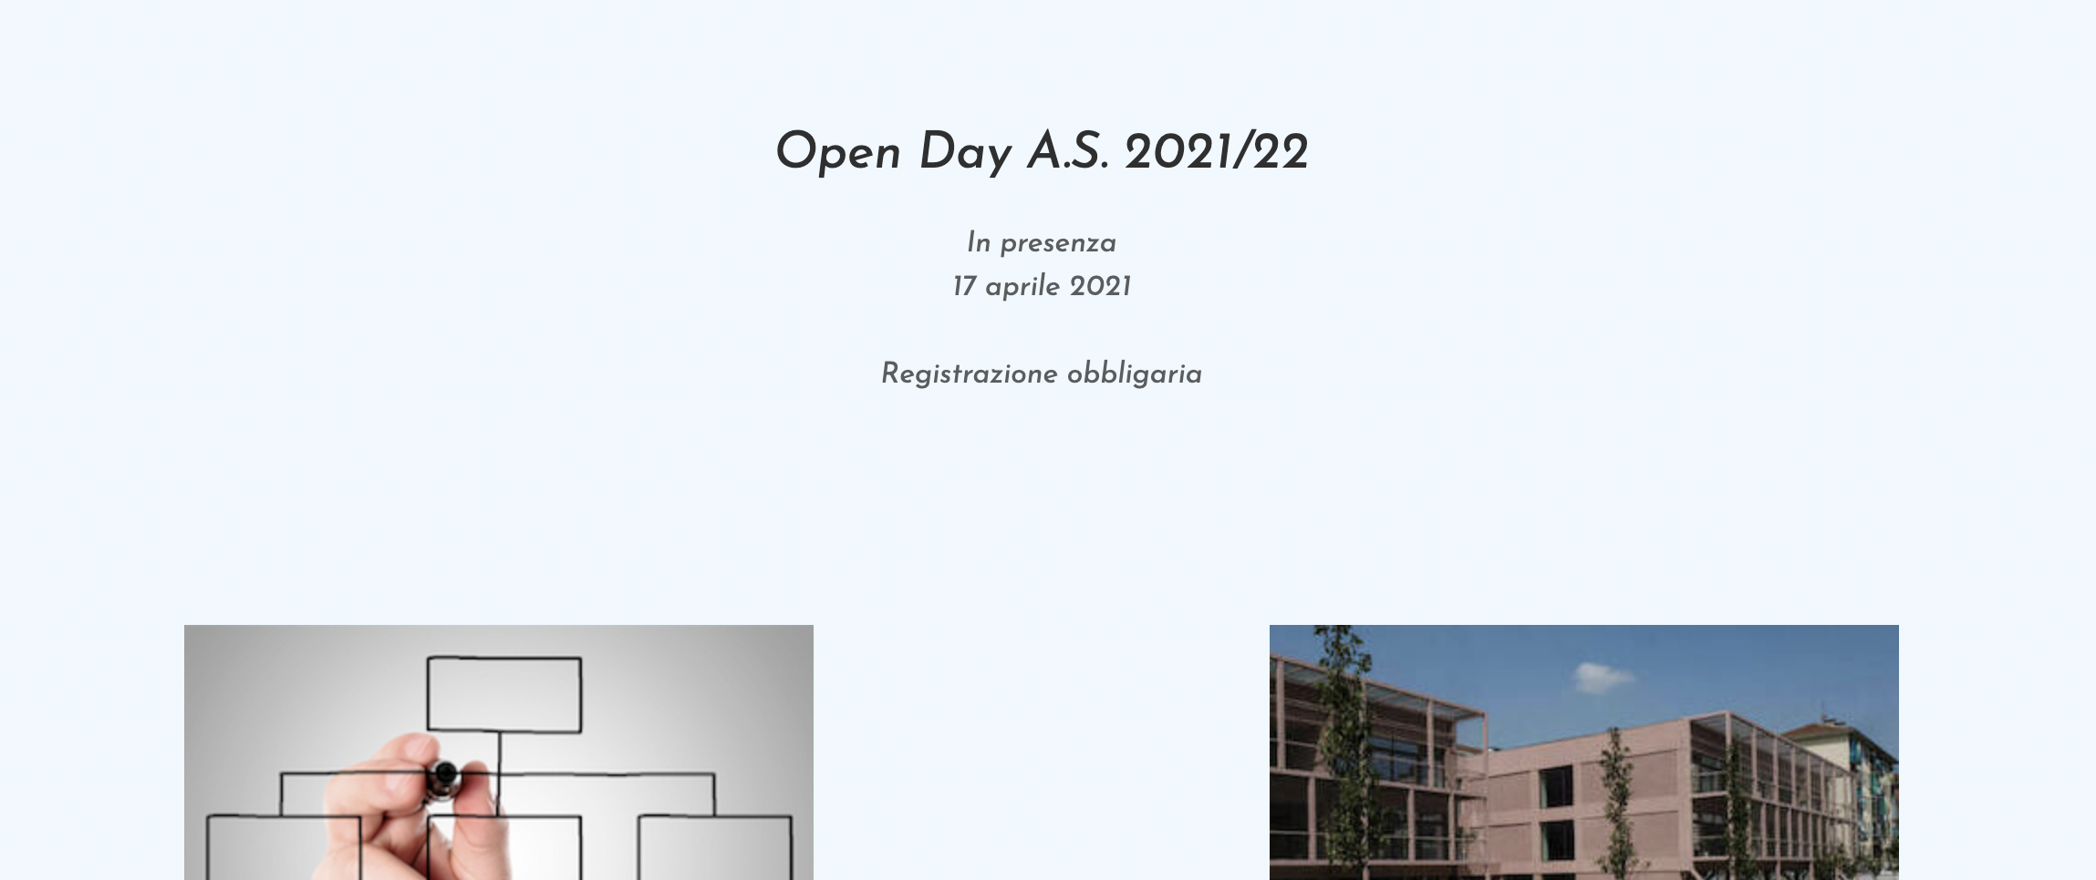
p
714px
96px

Slide 6

div.d-flex
1190px
667px

Slide 7

img
345px
200px

Slide 8

Footer
100% dello schermo
358px

Slide 9


Address
1290px
18px
122px
50px
1290px
Social
img
50px

